Slide 1

iEBP

Slide 2
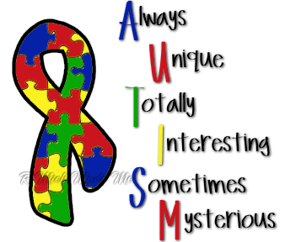
Autism EBP group
First meeting held in September 2010
56 group members, broad range of SPs in disability, community, ADHC, private practice, autism-specific preschools, specialised (e.g. ASPECT, ABI, CP), NGOs etc.

Slide 3
Critically Appraised Topics
In children less than 3 years of age with autism who are preverbal, does a Hanen MTW approach compared to a PECS approach result in improved social communication skills?
In children with autism, does video instruction improve the effectiveness of social communication skills?
In children with autism, does the use of i technology (e.g. ipads, iphones) result in improved social communication skills?

Slide 4
PECS vs MTW
Flippin M., Reszka S., & Watson L. (2010). Effectiveness of the Picture Exchange Communication System (PECS) on Communication and Speech for Children with Autism – Spectrum Disorders: A Meta-Analysis. American Journal of Speech and Language Pathology, 19, 178-195.
Level - IV
McConachie H., Randle V., Hammal D. & Le Couteur A. (2005). A controlled trial of a training course for parents of children with suspected autism spectrum disorder. The Journal of Pediatrics, 147, pp 335-340.
Level - III
Carter A. S., Messinger D. S., Stone W. L., Celimi S., Nahmias A. D. & Yoder P. (2011). A randomized controlled trial of Hanen’s ‘More Than Words’ in toddlers with early autism symptoms. Journal of Child Psychology and Psychiatry 52 (7), 741-752.
Level - II
Girolametto L., Sussman F., & Weitzman E. (2007). Using case study methods to investigate the effects of interactive intervention for children with autism spectrum disorders. Journal of Communication Disorders, 40, 470-492.
Level - IV

Slide 5
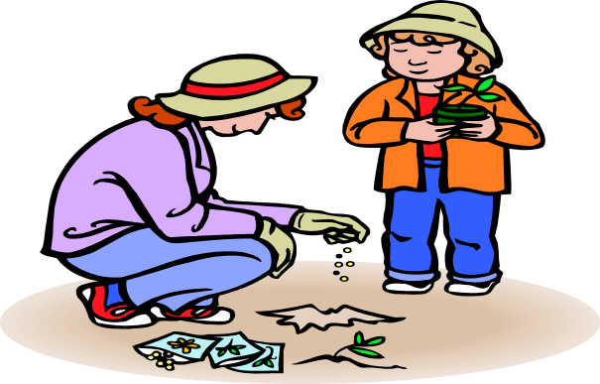
More Than Words – Bottom Line
There is some evidence that parent participation in MTW may result in an increase in vocabulary size though a causal link cannot be proven.
There is not enough evidence to demonstrate that participation in MTW improves overall social communication skills.

Slide 6
Interesting Findings - MTW
No improvement in social communication (ADOS as a measure) – McConachie et. al (2005).
Increase in parents use of facilitative strategies – McConachie et. al (2005).
No difference in parent stress level – McConachie et. al (2005).
MTW did not benefit all children – Carter et al (2011)
Increase in parent responsivity noted but not statistically significant and not maintained – Carter et al (2011)
Gains in JA for children <3 with limited object interest – Carter et al (2011)
Best outcomes reported by Girolametto et al (2007) – creators of Hanen programs – Level IV study – 3 subject pre test and post test design

Slide 7
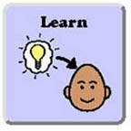
PECS – Bottom Line
There is some evidence that participation in a PECs intervention increases children’s social communication skills (measured by frequency of PECS exchanges, requests and initiations) but those few studies who looked at generalisation and/or maintenance found the evidence was not strong and most children regressed.
There was no evidence that PECs was beneficial to children specifically under 3 years, as the studies included children up to age 18.

Slide 8
Interesting Findings - PECS
Vocalizations generally developed in the later phases of PECs training (i.e. stages 4-6) (Bondy & Frost 1994)
Sign language was found to be a more effective intervention than PECS (Tincani 2004).
PECS was more effective in targeting communication outcomes for children who had lower frequencies of joint attention (Charlop-Christy et al).
Variable effects in PECS program showed that the program was not equally effective in improving speech outcomes for all children with autism (Flippin et al 2010).

Slide 9
PECS vs MTW Bottom Line
There is not adequate evidence to support the claim that either PECs or MTW interventions are effective in improving social communication skills in children under 3 that are maintained beyond the treatment period.
Neither therapy intervention appears to be equally effective for all children with autism, but may benefit subgroups of children with autism (MTW Children <3 with limited object interest, PECS children with lower frequencies of joint attention)
Further research is needed to determine whether these therapies may be effective in increasing social communication skills in children under 3 with autism who have specific communication deficits.

Slide 10

Video Modeling
Video modeling (VM) – a child is shown a video which depicts a desired behaviour in an appropriate context, and then asked to imitate the behaviour. A peer, sibling or adult may be used to model the behaviour or...
Video self modeling (VSM) – video is taken of the child successfully performing a behaviour
Point of view video modeling (PVM) – video is shot as if through the eyes of the child – showing what they would see in the situation

Slide 11
Video Modeling
Bellini S., & Akullian J. (2007). A Meta-Analysis of Video Modeling and Video Self-Modeling Interventions for Children and Adolescents with Autism Spectrum Disorders. Exceptional Children, 73, 3, 264-287.
Shukla-Mehta S., Miller T., & Callahan K. (2010). Evaluating the Effectiveness of Video Instruction on Social and Communication Skills Training for Children with Autism Spectrum Disorders: A Review of the Literature. Focus on Autism and Other Developmental Disabilities, 25:23.

Slide 12
Evidence
Both studies were reviews of existing studies
Smita Shukla Mehta – reviewed 26 studies published between 1980 – 2008 (total 104 participants)
25 - single subject research design (multiple baseline or
multiple probe). inc. 1-7 children (mean 3.16)
1 – matched random group comparison w/ 25 children
(Kroeger, Schultz & Newsom 2007).
Belini & Akullan – reviewed 23 studies published between 1980 – 2005 (total 73 participants )
22 multiple baseline or probe design and 1 reversal design. inc. 1-7 children (mean 3.55)
Overlap between reviews – 13 articles included in both

Slide 13
Video Modeling Bottom Line
Some evidence exists to support the use of videomodeling to improve social communication skills in autism (Smita Shukla-Mehta et al 2010, Bellini & Akullan 2007).
Due to inconsistencies in intervention across existing studies, Smita Shukla-Mehta et al suggested a clearer delineation of the aspects of intervention is needed in future research to determine whether videolmodeling can be considered evidence based intervention

Slide 14
Guidelines for Effective Video Instruction
Use instructional prompts and reinforcers or error correction
Need to evaluate child’s skills (attention, imitation, visual processing, comprehension, matching to sample, and spatial ability) to determine amount of content and length of video
Children more likely to benefit if able to attend to a video for at least 1 minute
Keep video clip between 3 and 5 minutes and view twice (more if children reinforced by watching videos)
Type of model does not appear to matter, though VSM appears to be less efficient than VM
Smita Shukla-Mehta et al 2010

Slide 15
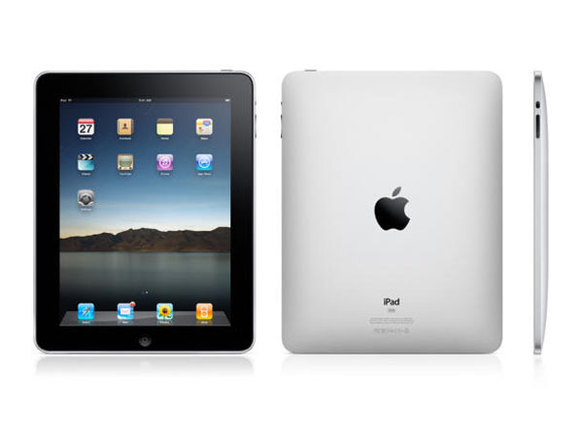

Slide 16

It’s in the media

Slide 17
But where’s the evidence?
Our clinical question:
In children less than 5 years with an ASD, does the use of i-technology (eg. iPads, iPhones) result in improved social communication skills?
Single Research Paper:
Flores, M. et al (2012) A comparison of Communication using the Apple iPad and a Picture Based System. Augmentative and Alternative Communication. 1-11

Slide 18
Results
Communication behaviours either increased when using the iPad or remained the same as when using PECS

Slide 19
Interestingly…
Technology is moving faster than our researchers:
2012 paper may be “out of date”
Media coverage focused on using “Proloquo2Go” as a communication device – only emerging research for this
Aspect is doing Australian research on a number of “apps” Proloquo2Go is one of these
Hundreds of “apps” on the app store targeting autism
  Searched for “autism” in the App store and over 648 apps
Designed by web designers, speech pathologists, parents, teachers?

Slide 20
Our Workplaces are committed
Sent a survey out to all members of the EBP committee
25 responses
19 staff members have access to an iPad (15 are work iPads, 5 use their own)
Common trends:
Some had work iPads but unable to use or download “apps” to them due to IT difficulties (harder in bigger workplaces)
Using iPads as rewards, additional skills – not just AAC
Using best practice strategies (eg. Schedules) on the iPad

Slide 21

The social world is changing
Sheldon and Amy “hanging out”

Slide 22
Bottom line:
2012 research article is already out of date
More research required
Specific to “apps” rather than iPad in general

Slide 23
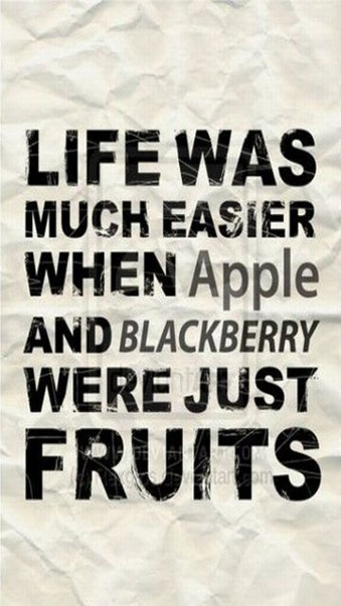
Notes:
Initiating joint attention:
Coordinated Joint Look: Child looks between adult and a toy to share attention. No more than 3 seconds must separate the look between the toy and the adult.
Showing: Child has object in hand and holds it towards adult to share attention.
Child does not give toy to adult.
Give to share: Child gives toy to adult. The child must make a clear attempt to give the toy to the adult.
Just a general thrust or throw in the direction of the adult is not acceptable. Child does not
want adult help. Child gives purely to share, e.g. for adult to look at a toy or for adult to
take a turn with a toy.
Proximal Point: Child points to an object within 4 inches of object purely to share interest with the adult.
Child’s finger does not need to be touching object.
Distal Point: Child points to an object which is more than 4 inches away from pointing finger purely
to share interest with the adult. Child does not want adult to act on the toy.
Responsive Joint Attention:
Following proximal point: After adult points (to object within 4 inches of pointing finger), child responds
with an attentional focus. The child’s eye-gaze shifts to focus on the object that the
adult is pointing to.
Following distal point: Child follows adult distal point (at least 4 inches away from object). The child’s eye-gaze
shifts to focus on the object that the adult is pointing to.
(Kasari, Freeman et al 2006)

Slide 24
Future directions…
Next topic will look at therapy targeting play skills in children with autism
Continue to meet at Croydon 5 x per year. Dates have now been set. Please contact leaders for details.

Slide 25
Thank you
Amanda Brignell for keeping the group together while I was gone, and Ann Linich for all her help
Group members for sharing the job of compiling the CAPs and another very productive year
Carissa Louwen for organising the room bookings
Julia Bye for helping out while Amanda is on secondment
And of course, Anita for helping so much with our presentation today

