Slide 1
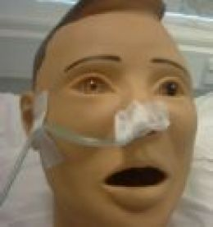
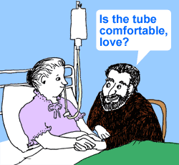
Nasogastric Tubes: Do they affect more than just your good looks?
Image from www.aphasiahelp.org
Adult Swallowing EBP Group
NSW EBP Extravaganza
4th December 2012

Slide 2
Presentation Outline
Background
Clinical question
External evidence: CAT process
Internal evidence: clinical experience
Clinical application

Slide 3
Background
Nasogastric tubes (NGT) – common alternate mode of nutrition, hydration and medication administration
Clinical experience dictates negative association between NGT and swallow function
Paucity of literature
Clinical considerations:
- fine bore versus large bore
- duration in situ
Previously investigated by Central Sydney Area clinical network in 2008
Notes:
Dysphagia is a common complication in the neurological population and an important issue to address as it causes aspiration, malnutrition and dehydration. Statistics show that temporary dysphagia affects up to 50% of stroke patients in the acute stage of their illness, and often requires tube feeding (Dziewas et al 2003). Nasogastric tube feeding is the most widely used non oral method for maintenance of adequate nutrition. A nasogastric tube is a foreign object inserted through the nostril and follows the same bolus path as the pharynx and eosphageous.
NG tube feeding has been recommended as safe, relatively non invasive and generally well tolerated by patients. It has been reported (Huggins et al., 1999) that NG tubes DO HAVE an EFFECT on the swallowing function of healthy individuals, with the size of the NG also having an impact. Theoretically and based on assumption, an NG tube will have negative impacts on the swallowing function and efficiency on clients with dysphagia, as they have declined compensatory swallowing ability vs. healthy people. However, studies and literature on the effects of NG tubes on the swallowing function of dysphagic individuals are lacking. Possible reasons for the paucity of this data could be small sample sizes and varying methodologies to determine the impact of NG tubes on swallowing function. Size of the NG tube i.e. fine bore vs large bore, and duration of the NG tube in situ should be considered to determine clinical practice.
As a group, we felt that there was no positive relationship between NGT presence and swallow function. In most cases, we felt that NGTs either had no impact, or had a harmful effect on swallow function.
In conjunction, members of our group were not able to recall any specific research supporting their clinical judgment.
We had other questions that we were interested in: whether choice of fine bore or large bore made a difference, or whether the duration in situ was important in outcomes.
The Central Sydney Area respiratory and critical care clinical network began to investigate the impact of NGT on swallowing in
Following the investigations of _______ by the Central Sydney Area clinical network in _____,we decided that further research and investigation of this topic will guide our clinical experience and knowledge in working with our clients and NG tubes.

Slide 4
Clinical Question
What is the impact of nasogastric tubes on swallow function in adults?
Notes:
Justification for healthy + sick, fine + wide, MBS + FEES + neither, etc.

Slide 5
CAPped Articles
Dziewas, R., Warnecke, T., Hamacher, C., Oelenberg, S., Teismann, I., Kraemer, C., Ritter, M., Ringelstein, E.B., & Shaebitz, W.R., (2008). Do nasogastric tubes worsen dysphagia in patients with acute stroke? BMC Neurology, 8:28
Fattal, M., Suiterm D.M., Warner, H.L., & Leder, S.B., (2011). Effect of presence/ absence of a nasogastric tube in the same person on incidence of aspiration. Otolaryngology – Head & Neck Surgery, 145:5, pp796-800
Huggins, P.S., Tuomi, S.K., & Young, C., (1999). Effects of nasogastric tubes on the young, normal swallowing mechanism. Dysphagia, 14:3, pp157-161
Leder, S.B., & Suiter, D.M., (2008). Effects of nasogastric tubes on incidence of aspiration. Archives of Physical & Medical Rehabilitation, 89
Wang, T., Wu, M., Chang, Y., Hsiao, T., & Lien, I., (2006). The effect of nasogastric tubes on swallowing function in persons with dysphagia following stroke. Archives of Physical & Medical Rehabilitation, 87:9, pp1270-1273
Notes:
List of CAPped articles
In speech – include number of articles found, and number relevant. Reasons for same?
Found 42 articles
Only 5 relevant to our discussion
Distinction between aspiration due to reflux or incorrect placement vs oropharyngeal dysphagia.

Slide 6
Summary of CAPs
Article | Level | Participants | Method | Outcome Measures | Results | Impact on Swallow?
Dziewas et al, 2008 | IV | Part 1 – 100 Part 2 – 25 Stroke | Part 1 – Case series. Freq. & outcome of NGT misplacement. Part 2 – Repeated measures design. Ax pre- & post-NGT insertion. | FEES – Incidence of aspiration. Salient endoscopic finding. | Part 1 – NGT coiled in pharynx = worsened dysphagia Part 2 – Nil | No
Fattal et al, 2011 | III-2 | Grp 1 (21) w/ NGT Grp 2 (41) w/o NGT Mixed medical | Crossover design. Pre- & post Ax w NGT removal ( Gr1) or insertion (Gr2). | FEES – Incidence of aspiration | Nil | No
Huggins et al, 1999 | IV | 10 Young, healthy adults | Repeated measures design. Three conditions: no NGT, fine bore, wide bore. | VF – 5 temporal and 3 non-temporal measures | Wide bore = increased duration of 4/5 events | Slight Fine bore > wide bore?
Leder & Suiter, 2008 | III-2 | Grp 1 (630) w/ NGT Grp 2 (630) w/o NGT Mixed medical | 7 year , prospective cohort series. Single instance Ax. | FEES – Incidence of aspiration | Nil | No
Wang et al, 2006 | IV | 22 Stroke NGT insitu > 2 weeks | Repeated measures design. Ax pre- & post-NGT removal. | MBS – timed & qualitative obs | Nil | No
Notes:
Leder & Suiter 2008 – mixed medical including pulmonary, left stroke, right stroke, brainstem, parkinson’s disease, dementia.
No indication of how patients were allocated to a group ?random, medical team, severity
Combination fine bore and large bore NGT but nil data to assess outcome
No indication of duration with NGT prior to FEES
Fattal et al 2011 – crossover design = Group 1 had NGT in situ, scoped, NGT removed then 5 minutes later rescoped. Vice versa for Group 2.
Huggins – wide bore tube compared to no NGT = early pharyngeal swallow response compared, longer period of hyoid excursion, increased duration of bolus transit through pharynx, lengthened upper oesophageal sphincter opening. No differences in occurrence of aspiration between groups.
??DURATION WITH NGT IN?

Slide 7
External Evidence:
Strengths and Limitations
Use of objective assessment tools
  Time frame parameters
  Rating scales
Study design and bias
Impact of NGT reviewed in healthy population
Comparison of NGT size
Varying participant populations
Notes:
All five studies used objective assessment; 3 studies (Fatel, Dziewas and Leder) used FEES and the other two used MBS (Wang and Huggins). Two of the studies (Huggins and Wang) looked at specific time frames of MBS to further objectify information e.g. Swallow duration times. Rating scales were also used for swallow aspects such as residue, penetration and aspiration to also make data more objective (Fatel and Dziewas). We do need to note however the limitations of FEES examination as it does not let you observe aspiration during the swallow. Despite attempts to make observations objective they still rely on subjective judgements.
Clear presentations of study design and methodology were particularly good in Fattel, Wang, Huggins et al’s studies; making it easy to replicate. Two studies (Fatel and Leder) used control groups which add to the reliability of the data. Inclusions of both objective and qualitative measures used in Wang and Dziewas studies to look at overall impact on swallow function not just aspiration. Two studies (Fatel and Leder) only looked at presence or absence of penetration and aspiration which means they do not take into account overall impact of NGT on swallow function.
Two studies had reasonable sample sizes: Large sample size with Leder 1260 participants, 1 x reasonable sample size (125) in stroke population Dziewas study. However small sample sizes is a weakness for the other 3 studies with Small numbers of participants (62Fattal, 10Huggins,22Wang) impacting on ability to generalise and the reliability of information . Exclusion criteria may mean not representative of general dysphagia population e.g. Wang et al’s study excluded patients with more than minor amounts of aspiration and Dziewas et al excluded medically unstable patients
Attempts to avoid bias were used, In Dziewas et al study they recorded FEES assessments and reviewed randomly offline, Random selection of swallows reviewed in Huggins study in both conditions for participants. Randomisation was not used in Fetel and Dziewas et al’s studies which may lead information to be subject to bias. Possible bias in studies may occur without inter-rater reliability achieved in Wang et al and Leder et al’s studies. Although study designs attempted to eliminate bias by looking at randomly selected swallows for review consideration of how representative this information is when swallows heterogeneity is known and also documented in the dueies with variation between swallow to swallow. For example 12/60 swallows selected in Huggins et al study. Wang et al’s study also looked at the shortest swallow time for review with Variations commented on for swallowing time at each assessment noted and only shortest time recorded. Again this needs to be considered as to whether it impacts on the significance of results.
Lack of specificity of length of NGT insertion and failure of all studies to consider these impacts on swallow function. Only one study ( Wang et al) commented that NGT had been in situ for more than 2 weeks.
Small timeframe’s post NGT removal for review does not consider effects such as oedema and other impacts on swallow function. Therefore can we actually make these conclusions for general use in dysphagia populations without addressing these limitations?
In one study (Fattel et al) reviewed swallow function 5 minutes after NGT removal.
Dziewas study looked at most 1 hour post removal with FEES performed immediately after NGT removal
Wang 30 minutes post removal
One study reviewed the impact of NGT presence in a young population without the presence of dysphagia. This is a useful study that serves as a control in many ways but is limited by decreased ability to generalise to our usual aged and dysphagic populations.
Comparisons were made between large and fine bore NGT impacts on swallow function in Fattal, Huggins. This is something that clinically at bedside is believed to impact further on swallow function. Further studies are needed with larger numbers of those with large bore tubes in comparison to fine bore tubes. Leder, Wang, Dziewas studies did not compare large vs fine bore NGT effects at all. Despite Fattel’s study comparing tube size there were more participants with fine bore tubes.
A variety of patient populations were looked at with the five studies, one “healthy”, 2 with stroke populations and 2 with more non-specific general medical conditions. This can be both a strength and a weakness in regards to generalisation and specificity.
--------------------------------------------
All five studies used objective assessment; 3 studies (Fatel, Dziewas and Leder) used FEES and the other two used MBS ( Wang and Huggins). Two of the studies (Huggins and Wang) looked at specific time frames of MBS to further objectify information e.g. Swallow duration times. Rating scales were used for swallow aspects such as residue, penetration and aspiration to also make data more objective (Fatel and Dziewas). We do note the limitations of FEES examination as it does not let you observe aspiration during the swallow. Despite attempts to make observations objective all studies still rely on subjective judgements.
Clear presentations of study design and methodology were particularly good in 3 of the studies (fatel, wang, huggins et al’s studies); making them easy to replicate. Two studies (Fatel and Leder) used control groups which add to the reliability of the data. Inclusions of both objective and qualitative measures used in (Wang and Dziewas) 2 studies looking at overall impact on swallow function not just aspiration. Where as 2 studies (Fatel and Leder) only looked at presence or absence of penetration and aspiration which does not account for overall impact of NGT on swallow function. Two studies had reasonable participant sizes; (Leder 1260 participants, 1 x sample size 125 in stroke population); However small sample sizes is a weakness for the other 3 studies with Small numbers of participants (62Fattal, 10Huggins,22Wang) which impacts on ability to generalise and the reliability of data . Exclusionary criteria’s used may mean samples not representative of general dysphagia population (e.g. Wang et al’s study excluded patients with more than minor amounts of aspiration and Dziewas et al excluded medically unstable patients)
Attempts to avoid bias were used, (In Dziewas et al) One study recorded FEES assessments and reviewed randomly offline, Random selection of swallows reviewed in Huggins study. Randomisation was not used in 2 studies (Fetel and Dziewas et al’s studies) which may be subject to bias. Possible bias in studies may occur without inter-rater reliability achieved in Wang et al and Leder et al’s studies. Study designs attempts to eliminate bias may impact on how representative this information is when swallows heterogeneity is known and also documented with variation between swallow to swallow. For example 12/60 swallows selected in Huggins et al study with Variations commented on for swallowing time at each assessment noted; Again this needs to be considered around the impact on the significance of results.
All studies reviewed lacked specificity around the length of time NGT were inserted. All studies reviewed did not consider the impact of time inserted on swallow function; including small timeframe’s post NGT removal for review. None of the studies Considered factors such as oedema and other impacts on swallow function from long periods of NGT insertion. Therefore there are limitations around the conclusions made for general use in dysphagia populations without addressing these limitations.
One study reviewed the impact of NGT presence in a young population without the presence of dysphagia. This is a useful study that serves as a control in many ways but is limited by decreased ability to generalise to our usual dysphagic populations.
Comparisons were made between large and fine bore NGT impacts on swallow function in 2 studies (Fattal, Huggins). Only small numbers of participants and uneven numbers used for comparison of NGT size.This is something that clinically is believed to impact further on swallow function. Further studies are needed to compare impacts of NGT size.
A variety of patient populations were looked at with the five studies, one “healthy”, 2 with stroke populations and 2 with more non-specific general medical conditions. This can be both a strength and a weakness in regards to generalisation and specificity.

Slide 8
Clinical Question: Answered?
Level of evidence – III-2 or IV
Clinical bottom line
  The current evidence says that there is no significant impact of nasogastric tubes on swallowing function in adults.
But this didn’t sit with our clinical judgment!

Slide 9
Internal Evidence
Aim
  To explore the current viewpoints and practices of speech pathologists working in adult dysphagia in regards to our clinical question
10 question survey
Distributed widely
Analysis of data
Limitations
Notes:
External evidence did not reflect clinical observations or ‘gut feeling’ within the group
Working party formed to create 10 question survey after whole group discussion. Mix of qual and quant, options to provide comments and case examples throughout.
Survey created via survey monkey and distributed widely via SPECS, NSW SP managers networks and throughout individual departments
Invited SPs currently working in area of adult swallowing to complete this anonymous questionnaire
Survey monkey - Able to access only 100 out of 118 responses. Inaccurate calculations when results pulled. Careful review of dates and times to ensure accurate data analysed. Unable to simply compare responses across questions.
Data analysis – shared across the working party. Simple graphs and charts for numerical data. Modified thematic analysis of qualitative data – reading, rereading, identifying keywords, grouping keywords into themes, summarising.
Survey limitations – wording for some questions was vague, demographics – practicing SPs from NSW vs Australia vs international

Slide 10
Results: Demographics
Demographics of Participants
Years in adult dysphagia | <1 |  | 1-3 years |  | 4-8 years |  | 8+ | Unknown
 | 2% |  | 20% |  | 41% |  | 36% | 1%
Majority work setting | Acute |  | Subacute |  | Rehab |  | Community
 | 77 |  | 27 |  | 37 |  | 13
Current caseload | H&N | Aged Care | TBI | Neuro | Rehab | Gen med/ surg | ICU/ critical care | Other
 | 22 | 40 | 20 | 67 | 39 | 48 | 31 | 4
Notes:
Also – percentage caseload requiring NGT, 3 participants had not had any pts in the last 6 months with an NGT, the remaining 97 participants had had varying frequency of patients requiring NGT during their intervention. Large majority estimated 5-50% of patients with NGT.

Slide 11
Results: Frequency of Impact
% of Speech Pathologists

Slide 12
Results: Impact of NGTs
Two predominant features:
  Altered sensation
  Pharyngeal residue
Less predominant features:
  Swallow initiation
  Pharyngeal transit
  Epiglottic deflection
  UES opening
  Changes to mucosa
  Soft palate elevation and BOT to PPW approximation
Interesting features:
  Oral preparatory phase difficulties (bolus acceptance)
  Increase in presence of reflux
  Decreased motivation for oral trials/swallow rehab
Notes:
Unfortunately many people only commented that ‘sensation’ was impacted and/or that there was ‘pharyngeal residue’ present without offering any description (likely due to wording of the question)
Sensation: pain, hypersensitivity, irritation, discomfort, hyposensitivity, sensation of a ‘foreign body’, odynophagia, globus sensation
Pharyngeal residue: increase in residue sticking around tube - texture dependent (thick or sticky), only with wide bore tubes, leads to aspiration of residue

Slide 13
Results: Objective Ax
Objective Ax via MBS | Objective Ax via FEES | No Objective Ax
43 | 10 | 54
Poor soft palate closure resulting in nasal regurgitation Pharyngeal residue Residue around the tube Multiple swallows to clear residue Reduced epiglottic deflection due to the presence of the NGT | Oedema of the posterior arytenoids Ulceration of the laryngeal surface of the epiglottis Narrowing of the valleculae and pyriform ? oedema due to NGT or the repeated re-insertions of NGT Dislocated cricoarytenoid joint | “Actually this is not possible to confirm unless one does an objective assessment before and immediately after the NGT has been removed and if there are no contributing factors, which of course there always is”
Notes:
In terms of the positive effects of NGT removal on swallowing, it included less pharyngeal residue, less prominent nasal regurgitation, improved epiglottic deflection and reduced aspiration risk. One stated a significant improvement, stating “one patient we thought was going to be NBM and need a long-term PEG based on MBS until we removed the NGT. And continued MBS. Immediate change.”
Many of the response reflected on external factors on the objective assessment. Many responses questioned the effect on a patient’s general improvement in medical status and nutrition, spontaneous recovery and the size of the NGT used.

Slide 14
Results: Timing and Size
% of Speech Pathologists
Notes:
Length of time in situ
depends on patient and depends on type of tube, sensation, globus, dampening, swelling, pain, negative impact on sensation and motor structures, reflux, psychological/behavioural components of longer term NGTs, ‘maladaptive swallowing behaviours’ as a result of ‘over-compensation’, greater likelihood of PEG and deprioritising oral feeding, patient’s potential ‘fear of swallowing’.
Size of tube
- Negatives of wide bore tube – reduced anatomical space and increased sensation (4), more pain/discomfort (8), “causes damage to pharyngeal structures” (1), affects velopharyngeal closure (1), epiglottic deflection (1) and impeded overall movement (1), residue can build up around wide bore tubes (1). One respondent highlighted that they felt wide bore has more of an impact based on their clinical experience and medical discussion. “[Wide bore] affects those with small pharynx and those who have a free flap after head and neck surgery” (1), a psychological impact on patients (2)
Benefits of fine bore - “posterior arytenoid oedema appeared reduced” once changed from wide bore to fine bore as observed via FEES.
No difference - No clear difference between both tubes was observed via modified barium swallows (2)
- Unclear - “wide bore helps with cricopharyngeal dysfunction?” (1), fine tubes can get blocked (2)..
Responses were impacted by the clinicians’ workplace experiences and practices re: tube purpose and use, i.e. no experience with wide bore tubes as limited to ICU, not ever referred patients with wide bore tubes as used for continuous suction vs gen sx patients always have wide bore for feeding vs wide bore not appropriate for feeding regimes.

Slide 15
Results: Removing NGTs
Barriers:
Reinsertion
Don’t agree with practice
Resources
Ongoing need for NGT
Conflict with other staff, e.g. Dietitians
Lack of evidence
Facilitators:
Proactive and supportive teams, NS, pts and families
Evidence of NGT impact
Staff competence
Number of Speech Pathologists

Slide 16
Clinical Bottom Line: Internal Evidence
Based on this survey, the large majority of speech pathologists who currently work in adult dysphagia across a wide range of settings and patient caseloads report that NGTs CAN impact on the function of the oral preparatory, oral and/or pharyngeal phase of the swallow.
Notes:
Disagreement between the two clinical bottom lines
What are we basing it on – objective assessments vs clinical bedside assessment/ gut feeling/ patient report
Outcome measures – presence or absence of aspiration, severity of dysphagia, residue. So many other factors contributing to swallow function were identified as potentially impacted by NGT. Consideration of patient perspective and factors not evident on objective ax.
Consideration of time NGT in situ
What is the significance of the internal evidence? Does it change our recommendations, should it change our practices?

Slide 17
Miss T.L.
28 y.o. female.
20/08/12 – admitted to WMH with sudden onset dysphagia (unable to swallow her own secretions or food/fluids) and dysphonia (hoarse voice)
Diagnosed with a variant of Guillain-Barré Syndrome (GBS) – neurological disorder
28/08/12 – initial MBS → NBM (silent aspiration)
18/09/12 – following neurological improvement (improved Mx of secretions, resolved dysphonia, nil tongue or soft palate deviation), repeat MBS was conducted

Slide 18
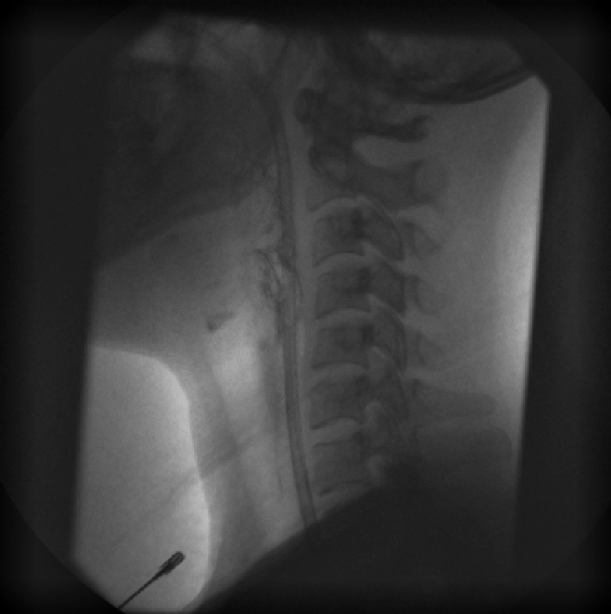
Initial thin fluid trial with NGT
Notes:
Repeat MBS
Reduced epiglottic deflection – aspiration of thin fluids

Slide 19

Post swallow of thin fluids
Notes:
Coating of trachea – residue from aspirated material

Slide 20
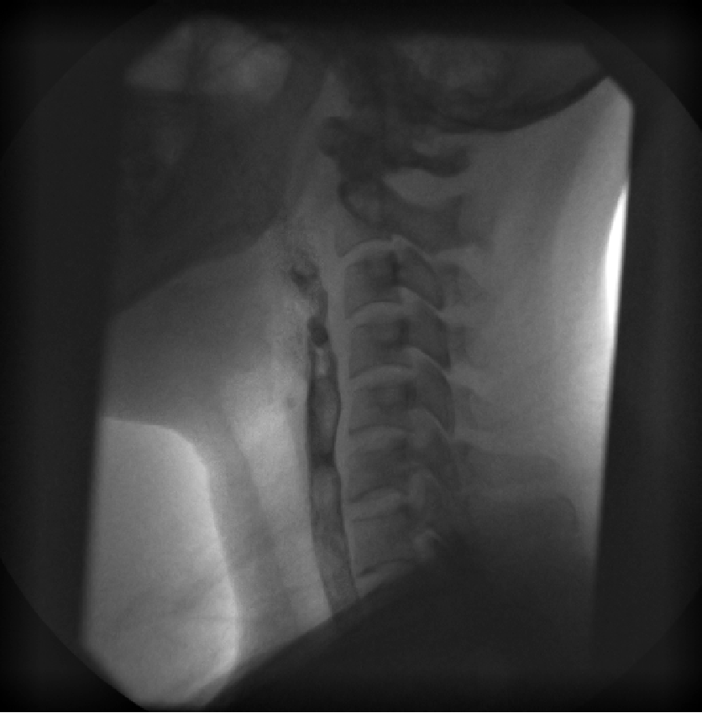
NGT removed
Notes:
Adequate epiglottic deflection – nil penetration/aspiration

Slide 21
Results of MBS
Without removal of NGT, recommendations:
  Puree diet and nectar thick fluids
With removal of NGT, recommendations:
  Puree diet and thin fluids
Repeat MBS 4 weeks later – patient upgraded to full diet and thin fluids

Slide 22
Where to from here?
CAPs/CAT to go on website
Collate internal evidence
Data collection across sites
Consideration of patient factors
Notes:
Need to collect more evidence and integrate findings from all three sources to answer clinical question
Then able to use this evidence to support rationales, explanations to teams and patients, and recommendations

Slide 23
For more information, please contact
Rosie Russell rosanne.russell@sswahs.nsw.gov.au
Elise Hamilton-Foster elise.hamilton-foster@swahs.health.nsw.gov.au

