Slide 1
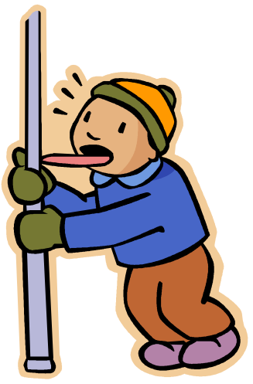
Don’t Stick Your Tongue Out at Me: Oral Motor Exercises in Paediatric Feeding (a Review of the Evidence)
Presentation by: Amanda Spirit-Jones, Clare Thomson, Eleni Haramis,
Kylie Ryan and Laura Mobbs

Slide 2

Who are we?
Name | Setting | Role
Amanda Spirit-Jones | Disability - NGO | Leader and appraiser
Emma Minchin | Disability – Government | Leader and appraiser
Tsen-Aie Levsen | Disability – Government | Leader and appraiser
Clare Thomson | Disability – Government | Appraiser
Eleni Haramis | Disability – Government | Appraiser
Kylie Ryan | Disability – Government | Appraiser
Laura Mobbs | Disability – Government | Appraiser
Kim Truong | Early Intervention - NGO | Appraiser
Dayna Ingram | Early Intervention - NGO | Member
Anne Hoffman | Disability – Government | Member
Lisa Jacob | Disability – Government | Member
Meghan Gold | Disability - NGO | Member

Slide 3


Clinical Question & PICO
Updating the 2006 CAT: In children with a disability does oral sensorimotor therapy improve oral skills in feeding?

Slide 4

Our search
SearchTerms/Systems:
(paed* OR ped* OR child*) AND (oromotor* OR "oral-motor"* OR "oral motor"* OR sensorimotor*) AND (feed* OR dysphag* OR eat* OR intake OR meal*) in Medline, EBSCO, ERIC, Cochrane, PsychInfo, Proquest, Pubmed, ScienceDirect
(paed* OR infant* OR neonat* OR pedi*) AND (disabilit*) AND (oromotor* OR "oral-motor"* OR "oral motor"* OR "oral sensorimotor" OR sensorimotor*) AND (intervention* OR therap*) AND (oral* OR feed* OR intake* OR eat*) in Google Scholar
''child* OR paed* OR infant* OR neonat* in title abstract keywords and disabilit* and oromotor* OR "oral motor"* OR "oral sensorimotor" OR sensorimotor* and intervention* OR therap* and oral* OR feed* OR intake* OR eat* in Cochrane Reviews'
Oral Motor Therapy, oral motor + Paediatric feeding,. ASHA: searched and reviewed the Pediatric Dysphagia Evidence Map (Treatment)- oral motor treatment in Speech Bite
Criteria for including an article:
Experimental or review articles published from 2006 onwards.
Children included in study 12months and older.

Slide 5

Results
Papers | Design | Level of Evidence | CAP/CASP Completed (Y/N)
Morgan et al (2012) | Cochrane Review | I | Y
Sigan et al (2013) | Pseduo RCT | III-1 | Y
Christiannse et al (2011) | Historical Control Study | III-3 | Y
Snider (2011) | Systematic Review | II-IV (range) | Y
Arvedson et al (2010) | Systematic Review | II-IV (range) | Y
Clawson et al (2007) | Case Series | IV | Y

Slide 6
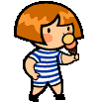
Articles CAPed
Sigan et al (2013)
Effects of Oral Motor Therapy in Children With Cerebral Palsy
Pseudo-randomised controlled trial investigating the effects of oral motor therapy on functional feeding skills in children with cerebral palsy.
Results suggest that oral motor therapy has a beneficial effect on oral motor functions in children with CP.
Methodological limitations, particularly insufficient description of the intervention techniques used, render replication in clinical practice unfeasible.

Slide 7

Morgan et al (2012)
Interventions for Oropharyngeal Dysphagia in Children with Neurological Impairment
Cochrane review (included level II and III-1 evidence) – 3 articles included.
Objective was to examine the evidence of interventions for oropharyngeal dysphagia in children with neurological impairment.
Currently insufficient high-quality evidence from RCT/quasi-RCT to provide conclusive results about the effectiveness of oral-motor therapy for children with neurological impairment.

Slide 8
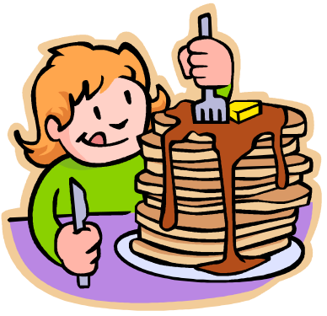
Christiaanse et al (2011)
Neuromuscular Electrical Stimulation is No More Effective Than Usual Care for the Treatment of Primary Dysphagia in Children
Retrospective non-randomised control trial.
NMES was conducted at a medical centre for an average of 22 sessions over 10 weeks and with an oral motor exercise home program.
Both treatment and control groups showed significant improvement on Functional Oral Intake Scale.

Slide 9
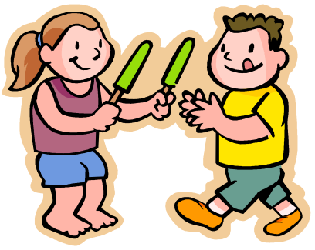
Snider (2011)
Feeding Interventions for Children with Cerebral Palsy: a Review Of The Evidence
Systematic review (included Level II, III and IV evidence).
The results indicate that, in children with CP, evidence for sensorimotor approaches improving oral-motor skills and reducing aspiration is conflicting.

Slide 10
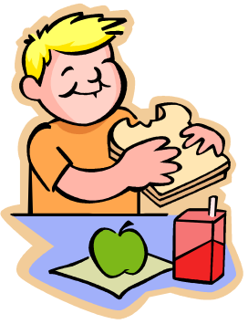
Clawson et al (2007)
Use of Behavioural Interventions and Parent Education to Address Feeding Difficulties in Young Children with Spastic Quadriplegic Cerebral Palsy
A quasi-experimental design study
Investigated effectiveness of Beckman’s oral motor exercises with behavioural interventions and parent education in 3 year ‘day patient’ program to increase oral feeding.
Overall, some improvement in growth reported, however, it is difficult to ascertain the effectiveness of oral motor exercises in isolation as it was part of a program.

Slide 11
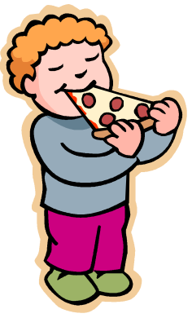
Arvedson et al (2010)
The Effects of Oral-Motor Exercises on Swallowing in Children: an Evidence-Based Systematic Review
Evidence-based systematic review (included Level II, III and IV evidence). Sixteen studies (1960-2007) included
Addressed impact of oral-motor exercises in children pertaining to four outcomes: swallowing physiology, pulmonary health, functional swallowing and drooling.
Mixed results were noted and those which resulted in a positive change were not statistically significant or did not provide sufficient detail to analyse.

Slide 12

Clinical Bottom Line
There is minimal low level evidence that oral sensorimotor therapy significantly improves eating skills/weight gain/growth/time taken to eat a meal/oral motor skills.
Small changes were seen when oral motor therapy was used during functional mealtime activities and in conjunction with other evidence based therapies such as parent training and home programs.

Slide 13
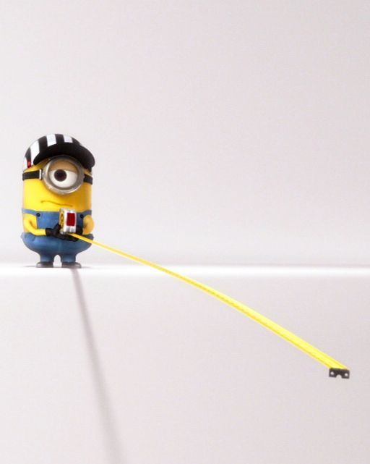
Our Reflection
Some clinicians will continue to recommend OMEs in isolation despite the limited evidence
We need to measure if our intervention works!
  Consider functional and realistic goals
  Use outcome measures:
    Dysphagia Disorders Survey
    Multidisciplinary Feeding Profile
    Goal Attainment Scales
Notes:
Not everyone will stop using OME on their own in light of the evidence
If you choose to use OME, consider the outcome measures used to monitor the effects for an individual client and does it help them meet their goals?
DDS
Multidisciplinary Feeding Profile (hard to get copy but used in research)
GAS – would capture all ICF domains

Slide 14

Application to Practice: E³BP
Minimal low level evidence to support OMEs
Current Best Evidence
We want to enjoy family meals
Should we practise eating to improve eating?
Clinical Expertise
Client/Patient Values
Notes:
Validity of bottom line in light of clinical practice, client values/preferences.
Evidence: Don’t do oral motor exercise on it’s own
Clinical: What we are doing clinically is taking a motor-learning approach (e.g. Therapeutic meals to practise chewing skills). Principles of experience-dependent neural plasticity and motor learning highlight that treatment should closely parallel the desired task
Client: much of drive from e3bp is around participation and enjoyment

Slide 15


Further Research
Neural Plasticity
Motor Learning
Participation
Oral Motor Exercises
Parents’ Perspectives
Notes:
Our CAT this year has instigated some discussion in our group about considering:
In light of what our clinical expertise is telling us in regard to improving the effects of oropharyngeal dysphagia in children we are interested to see what research is out there to support principles of motor learning and neural plasticity in children with dysphagia. Our CAPs have also highlighted the importance of considering the participation domain of the ICF model and parents’ perspective of mealtimes, so we may consider a qualitative CAT next year.

Slide 16

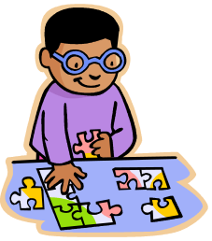
Next year
We’re open to new members and ideas (we don’t bite!)
Our group is very friendly and practical
We often discuss clinical cases along the way.
We’re keen to incorporate the voices of clients and families – help us put the pieces together!!
We offer therapeutic snacks in our meetings ☺
2015 meetings:
  10 February 2015, 1:30-3:30pm, CPA Kingswood
  21 April 2015, 1:30-3:30pm, Miller Community preschool.
  30 June 2015 , 1:30-3:30pm, ADHC Campbelltown
  18 August 2015, 1:30-3:30pm, ADHC Parramatta
Contact Amanda Spirit-Jones: aspiritjones@cerebralpalsy.org.au

Slide 17
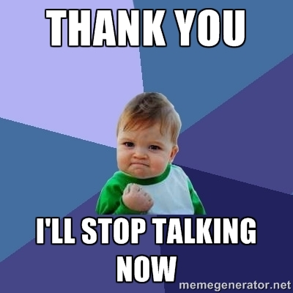
Thank you
All our group members and appraisers
NSW EBP Network Steering Committee
Goodbye to Emma Minchin & Tsen Levsen
Welcome to our new academic links
Dr. Leigha Dark and Dr. Bernice Mathisen

Slide 18

References
Arvedson, J., Clark, H., Lazarus, C., Schooling, T., & Frymark, T. (2010). The effects of oral-motor exercises on swallowing in children: An evidence-based systematic review. Developmental Medicine and Child Neurology,52(11), 1000-13.
Christiaanse, M.E., Mabe, B., Russell, G., Simeone, T.L, Fortunato, J., & Rubin, B. (2011). Neuromuscular electrical stimulation is no more effective than usual care for the treatment of primary dysphagia in children. Pediatric Pulmonology, 46(6), 559-65.
Clawson, E.P., Kuchinski, K.S. & Bach, R. (2007). Use of behavioural interventions and parent education to address feeding difficulties in young children with spastic quadriplegic cerebral palsy. NeuroRehabilitation, 22(5), 397-406.
Morgan, A.T., Dodrill, P. & Ward, E.C. (2012). Interventions for oropharyngeal dysphagia in children with neurological impairment. Cochrane Database of Systematic Reviews, Issue 10.
Sığan, S.N., Uzunhan, T.A., Aydınlı, N., Eraslan, E., Ekici, B., & Çalışkan, M. (2013). Effects of oral motor therapy in children with cerebral palsy. Annals of Indian Academy of Neurology, 16(3), 342–346.
Snider, L., Majnemer, A., & Darsaklis, V. (2011). Feeding interventions for children with cerebral palsy: A review of the evidence. Physical and Occupational Therapy in Pediatrics, 31(1), 58-77.

