Slide 1
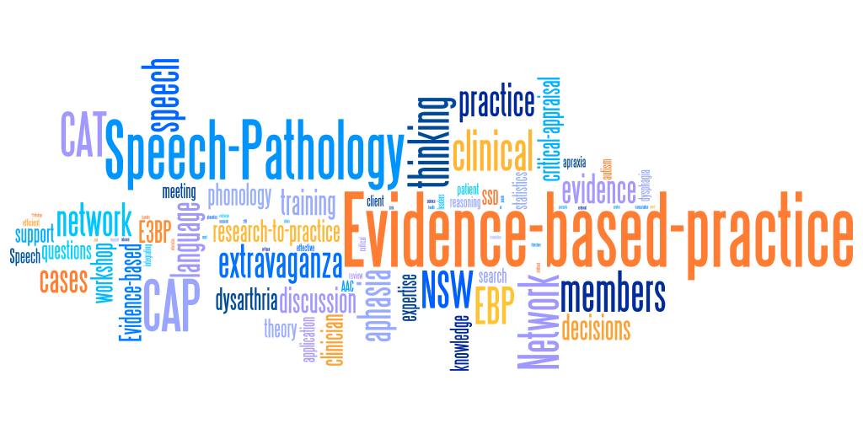
NSW Speech Pathology EBP Network Annual Showcase
Paediatric Speech
38 members
Leaders: Karen Nichols and Sarah Leung
Academic link: Dr. Elise Baker

Slide 2
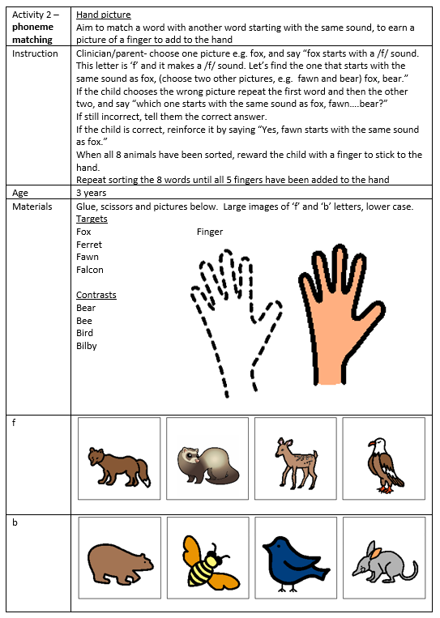
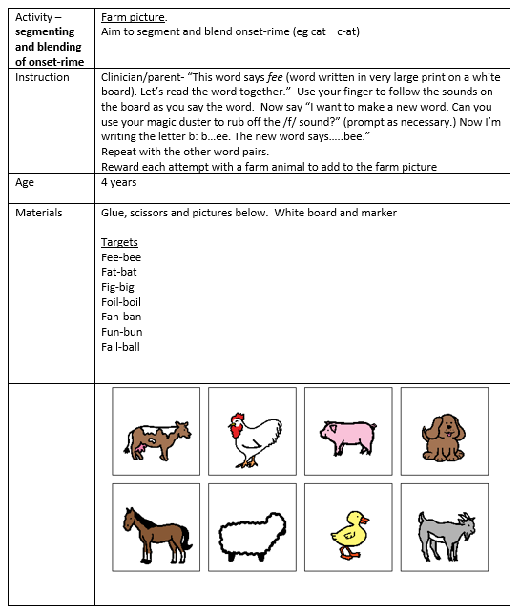
What have we focused on this year?
Finalized our ‘emergent literacy’ question from last year and developed clinical resources guided by the evidence
Started work on intervention for polysyllable difficulties in children

Slide 3
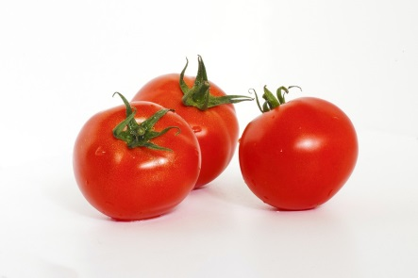
Transforming ‘mato’ into ‘tomato’:
Insights from evidence addressing polysyllable difficulties in children with speech sound disorder
Notes:
We know that polysyllables can be challenging for children with speech sound disorder. Listen to this production by a preschool-age child attempting to say ‘tomato’.

Slide 4
(1) Polysyllables are common in English
(2) Assessment helps avoid false negative cases
(3) Some difficulties only evident in polysyllables
(4) Difficulty with polysyllables can indicate risk of literacy difficulties
(5) Difficulty with polysyllables can provide insight into nature of a child’s expressive language difficulties
(6) Assessment can help with differential diagnosis and selection of appropriate polysyllable intervention
6 reasons why it is important to assess and treat polysyllables
Notes:
Ixn we looked at are for different child probs

Slide 5
PICO Clinical Question
PATIENT | In children with speech sound disorder does
INTERVENTION | intervention targeting polysyllables
COMPARISON | compared to no intervention or another intervention
OUTCOME | lead to improvement in measures of polysyllable accuracy (e.g., whole word correct, PPC, PCC, PVC, word length, syllable shape, lexical stress, % of omissions, altered sequence).

Slide 6
What did we find (so far)?
Authors | Number of participants | Research Design
Murray et al., (2015) | 26 | Randomized controlled trial
Thomas et al., (2018) | 5 | Single-case experimental design
Ballard et al., (2010) | 3 | Single-case experimental design
Young (1987) | 2 | Single-case experimental design
Young (1983) | - | Expert opinion
Velleman (2005) | 1 | Expert opinion and case study

Slide 7
Ballard et al., (2010)
ReST intervention for children with childhood apraxia of speech
3 children (7-10 years)
SCED involving ReST 4 x wk for 3 weeks
Targeted dysprosody using 3-syllable nonwords
Measured relative duration of Sw and sW syllables, smoothness, loudness and pitch
Bottomline: Improvements in untreated nonword stimuli; minimal improvement in real words, so more research needed.
Limitations: Limited participants; intensive > feasible in everyday clinical practice?
Notes:
Rest with older kids, speak to the clind bottom line

Slide 8
Murray et al., (2015)
ReST intervention for children with childhood apraxia of speech
26 children with CAS (4 to 10 years)
RCT compared Nuffield (NDP3) with Rapid Syllable Transition (ReST) 4 x wk for 3 weeks
ReST used 2- and 3-syllable nonwords with varied stress, targeting stress equalization and syllable segregation using PML
Bottomline: Both show generalization to nontreatment words
Limitations: Intensive > feasible in everyday clinical practice? No measure of generalisation to conversational speech
Notes:
Diff is that ballard only used 3 syll words, murray 2 & 3 with PML. Improvement on prev research. Like ballared the ixn is intense. No gen meaure

Slide 9
Thomas et al., (2018)
ReST intervention for children with childhood apraxia of speech
5 children 5;11 to 11;7 years
SCED examining clinician + parent-delivered ReST intervention 4 x wk for 3 weeks (50% @ home)
Bottomline: Mixed results > effective for 2 of 5 children; mixed fidelity of parent-delivered sessions, particular difficulty providing accurate feedback
Limitations: Limited participants and no measure of generalization to conversational speech.
Notes:
Trying to address feasibility. Looks promising but needs more feasibility research

Slide 10


Young (1983, 1987)
Intervention targeting weak syllable deletion in children with phonological impairment
‘83 = expert opinion
2 children (4;4 years and 4;5 years)
SCED 2 x wk; 50 productions per session
Intervention: Backward chaining with visual rebuses procedure with 4 steps including stress equalization followed by natural stress (e.g., bull > table)
Bottomline: Effective for both participants from treatment to non-treatment words.
Limitations: Only 2 children; no measure of conversational speech; rebuses changed weak stress to strong stress
Notes:
pA , but because of stress = not suitable for CAS, rebus words Sw not wS

Slide 11
Velleman (2002)
Intervention targeting weak syllable deletion in children with phonological impairment
Longitudinal case study (3;4 years > Kindy)
Teaching strategies informed by nonlinear phonology
  Polysyllables comprising CVCVCV words with opportunity for reduplication
  Start with iambic words embedded in a phrase comprising Swsw stress (e.g., big potato)
Bottomline: Nonlinear strategies could be helpful to inform elicitation strategies to producing polysyllables with natural stress
Limitations: Case study only.
Notes:
Addressed common prob WSD, case study, more exp opin informed by NLP.
Banana, chose words without fric and clusters
Phrase level not words.
Practical and helpful

Slide 12
Summary of papers found
SIX relevant papers identified (so far)…more to CAP
ReST
  Increasing evidence including RCT and SCED.
  Similar outcomes to Nuffield.
  Approach for children with CAS. Not suitable for children with phonological impairment.
Backward chaining with visual rebus
  Minimal and low level of evidence
  Suitable for children with phonological. NOT for CAS.
Teaching strategies informed by nonlinear phonology
  Suitable for children with phonological impairment
  Expert opinion only.

Slide 13
Clinical bottom line (so far)
It is possible to improve children’s productions of polysyllables
Unclear if parents can be coached to delivery intervention with high fidelity (ReST)

Slide 14
Implications for clinical practice (to far)
Need to consider the child’s type of SSD
Intervention based on frequent sessions for intensive period (2 to 3 x per week)
Need to measure generalization to nontreatment words and conversational speech
More research needed

Slide 15
What is our clinical group currently working on/plans for the future?
Continuing to work on polysyllable question > CAT
Topics for next year - looking at inconsistent speech disorder diagnosis and treatment, and differential diagnosis of SSD.
Interested in joining the group?
Contact:
Karen (Gwendolyn) Nichols Gwendolyn.Nichols@health.nsw.gov.au
  Sarah Leung Sarah.Leung@health.nsw.gov.au

