Slide 1
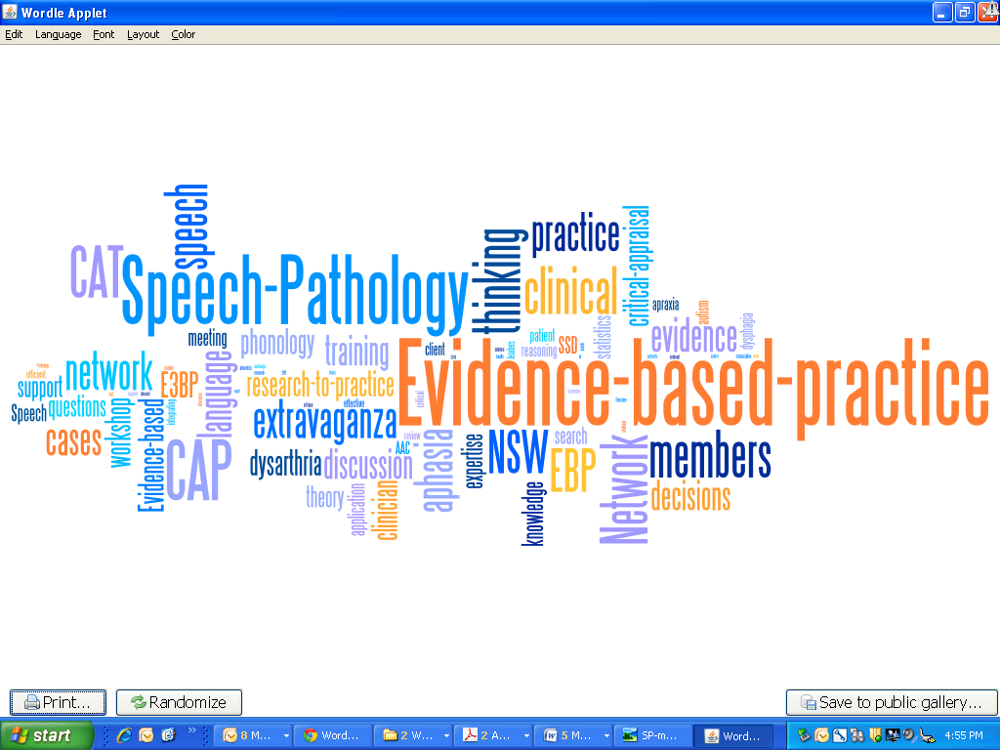
NSW Speech Pathology EBP Network
Autism EBP Group​
19 members​
Leader: Deborah Wilson

Slide 2
Clinical Question
For children on the Autism Spectrum is video modelling (particularly video self-modelling) more effective than treatment as usual for improving social skills?

Slide 3
What did we find?
Authors​ | Number of participants​ | Research Design​
Bellini et al., (2016)​ | 3 ​ | Case series​
Buggey, (2012)​ | 3​ | Single-case multiple-baseline design​
Dueñas et al., (2019)​ | 3​ | Multiple probe single subject design​
Huaqing Qi et al., (2017)​ | 24 studies (18 met criteria with 53 participants)​ | Systematic review​
Kabashi et al., (2017)​ | 3​ | Multiple probe single subject design​
Litras et al., (2010)​ | 1​ | Single case study​
Macpherson et al., (2015)​ | 4​ | Single-case multiple-baseline design​
Wilson, (2012)​ | 4​ | Single-case design​

Slide 4
Summary of papers found
8 relevant papers published since 2010 identified. These included:​
74 participants across these studies.​
7 case studies of level III-IV evidence ​
1 systematic review of level I evidence.

Slide 5
Clinical bottom line
Video modelling and video self-modelling can be considered EBP with moderate to strong effects on specific social skills for children on the Autism Spectrum.​
Some of the specific social skills taught were: ​
greetings, giving compliments, initiating play, following game rules​
Things to consider:​
Unknown factors impact on effectiveness for specific individuals.​
Evidence looked at preschool and primary age children within settings with typically developing peers to interact with.​
Generally small groups in articles

Slide 6
Implications for clinical practice
Video self-modeling is an effective tool to use in therapy.​
Technology has made this easier than ever to implement. IPads/ smart phones are easily accessible and socially accepted.​
Video modelling may improve client wellbeing and progress by reducing the social demands.​
Video modelling might be applicable for use across different types of skills- transitions, conversation skills, engaging in social games.​
It can be assumed that natural settings where opportunities for interaction with typically developing peers is ideal. Studies were conducted in natural setting where peer interactions might happen.​
Students and communication partners may benefit from additional training and support outside of this intervention.​
Long term maintenance and generalisation of skills taught is unclear as it has not been studied.

Slide 7
What is our clinical group currently working on/plans for the future?
We are considering the topic for next year. Possible topic includes Autism and... literacy, social programs, intervention method/setting.​
Continuing to meet 5 times per year via teleconference, with 2 articles to be discussed each meeting.

